Slide 1
Motion Sensing Claymore Mine
Sameer Malhotra and Samuel Skinner
Embedded Systems Spring 2019

Slide 2
Overview
What is a claymore?
Our Take
Design Overview
Hardware Design
Software Design
Web Display

Slide 3
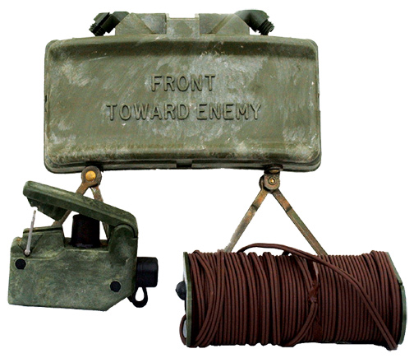
What is a claymore
Anti-personnel mine
Manually triggered
Electronic blasting cap
C4 explosive shoots ball bearings

Slide 4
High Level Description
Design a similar device for use as a training aid
LED strobe light and buzzer sound replaces explosion
Can be manually triggered or triggered via PIR
Trigger can be selected and armed via web interface

Slide 5
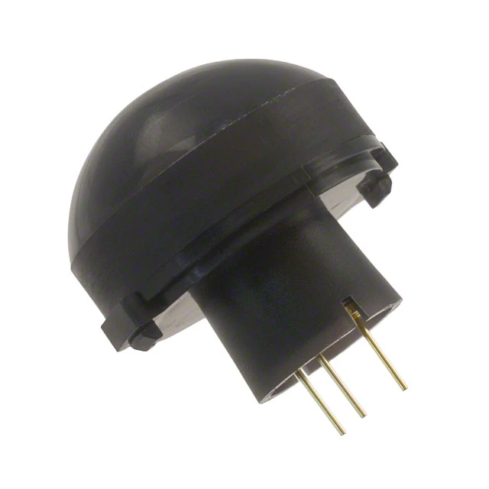

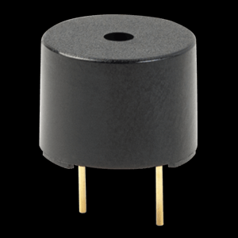
Design Overview/Technologies
Motion Sensor
Changes in infrared signature
Reflected as a voltage drop
Alarm
Buzzer
LED Panels
Web Display
Manual or motion sensing trigger
Armed or disarmed

Slide 6

Hardware Design

Slide 7

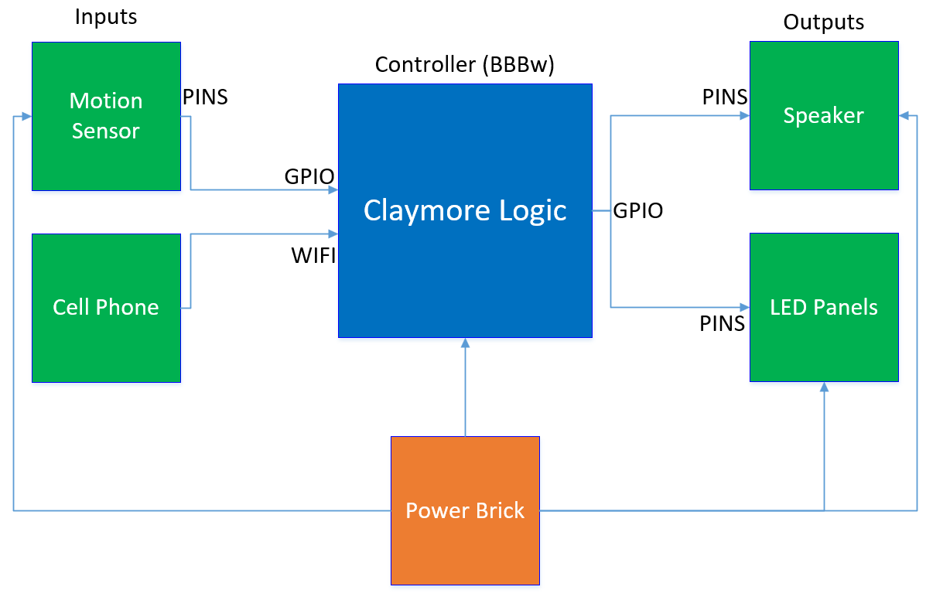
Block Diagram

Slide 8

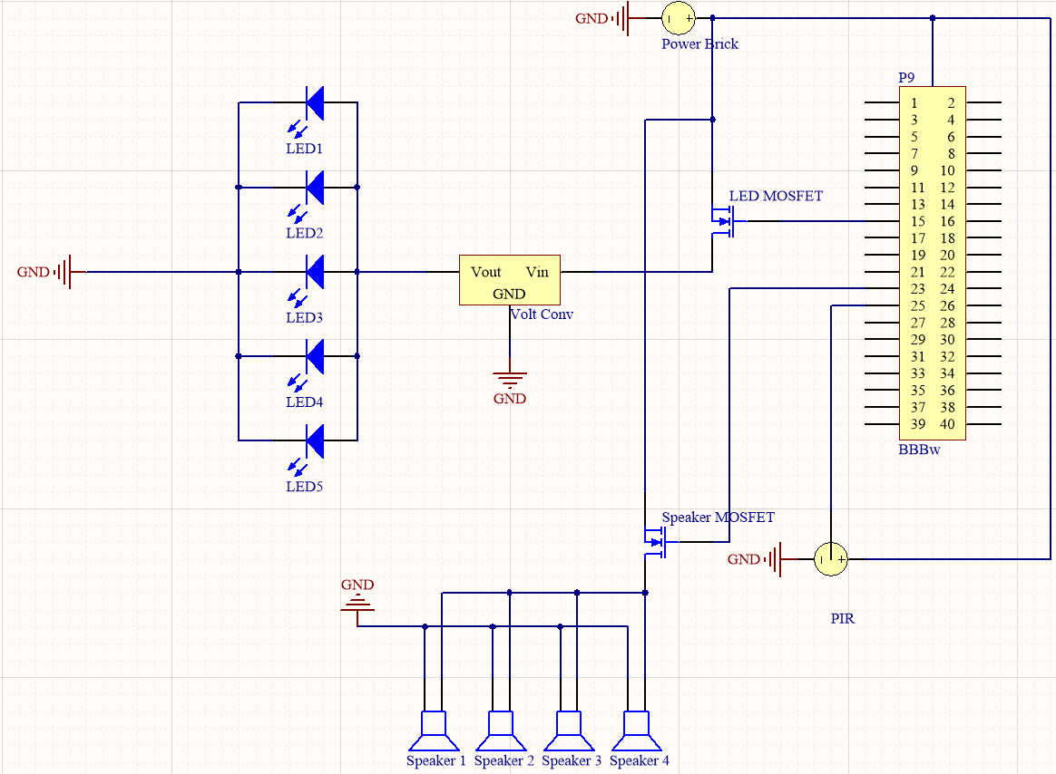
Schematic

Slide 9
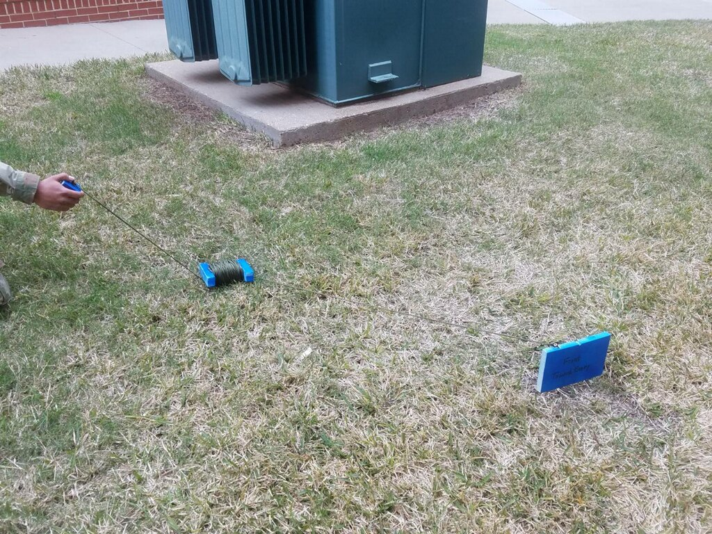
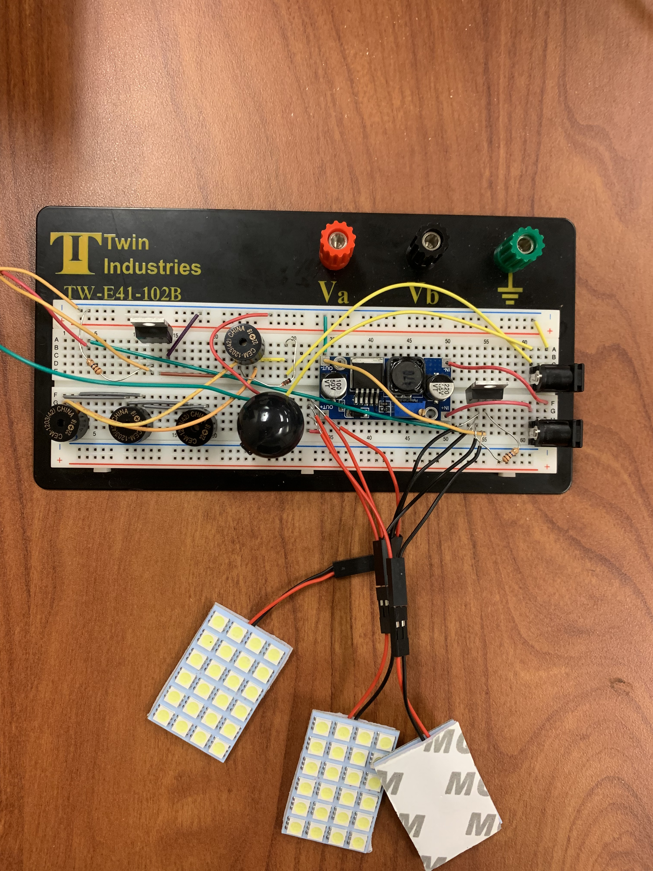
Hardware Integration

Slide 10
Hardware Changes
Initial LED panel was swapped for smaller segments
Buzzers replaced speaker to avoid AC current challenges

Slide 11

Software Design

Slide 12
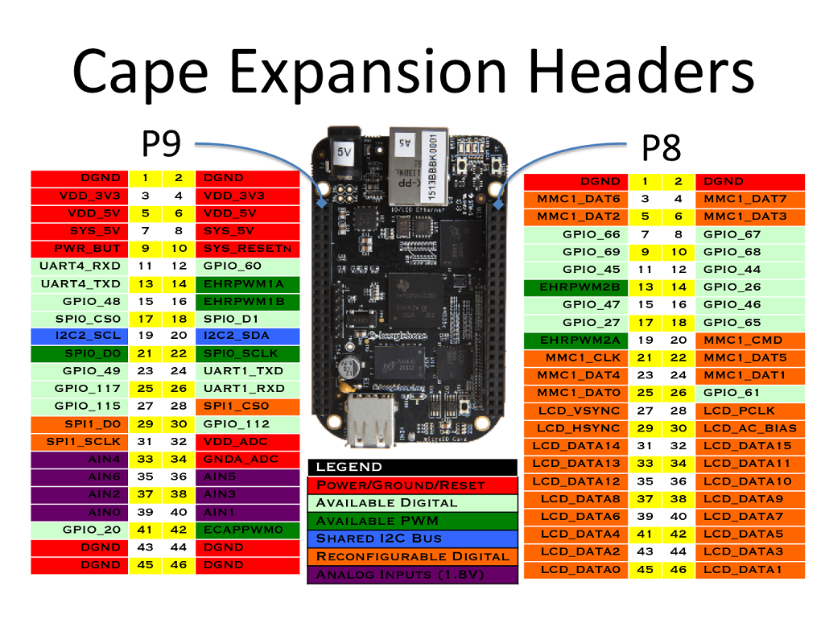
GPIO

Slide 13
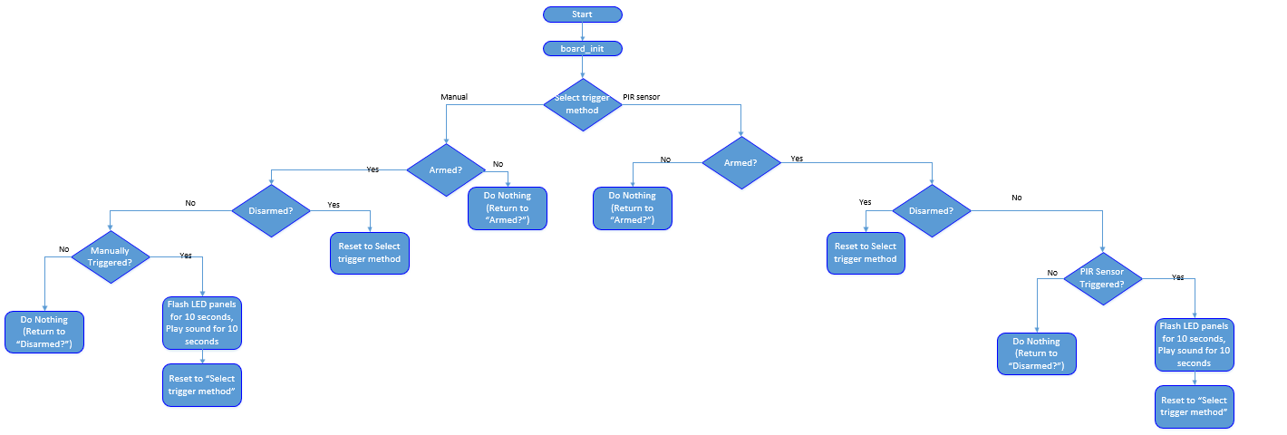
Current SW Design

Slide 14
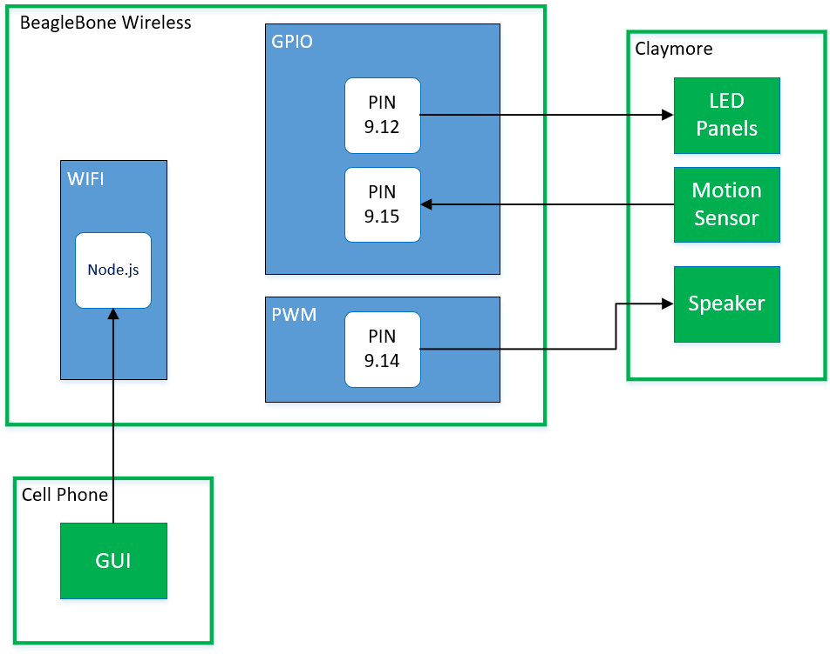
Functional Architecture

Slide 15
Software Changes
Writing a web interface in C is not feasible
Integrating many different pieces
Running on startup

Slide 16
Web Display

Slide 17
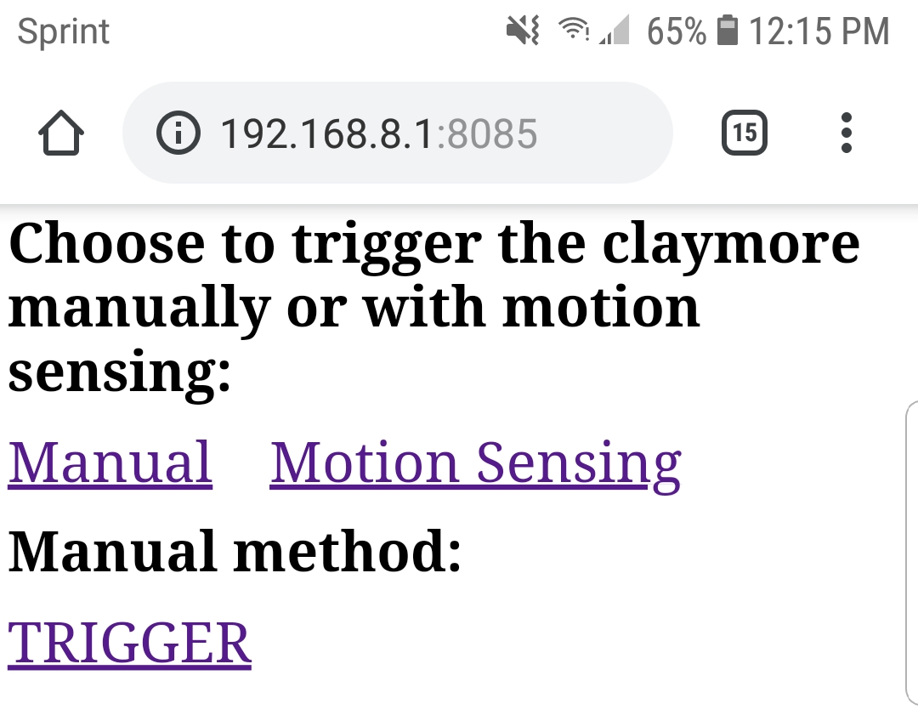
Web Display

Slide 18
Failures and Future Improvements

Slide 19
Failures/Lessons Learned
Java script is new
Integrating C, html, and java script is more complex than anticipated

Slide 20
Future Improvements
Weatherproofing/Casing
Improve ruggedness
Streamline setup and startup

Slide 21

Questions?

